Slide 1
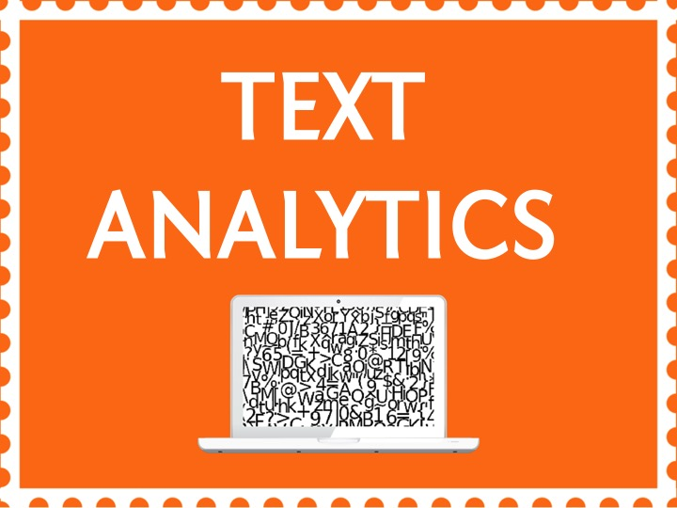

Slide 2
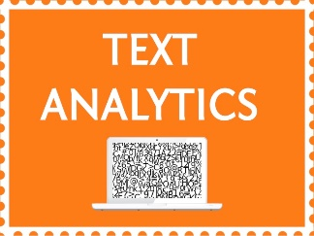

Topic – 7 Clustering
Text Analytics
Notes:
Do we know the topic number for this?

Slide 3
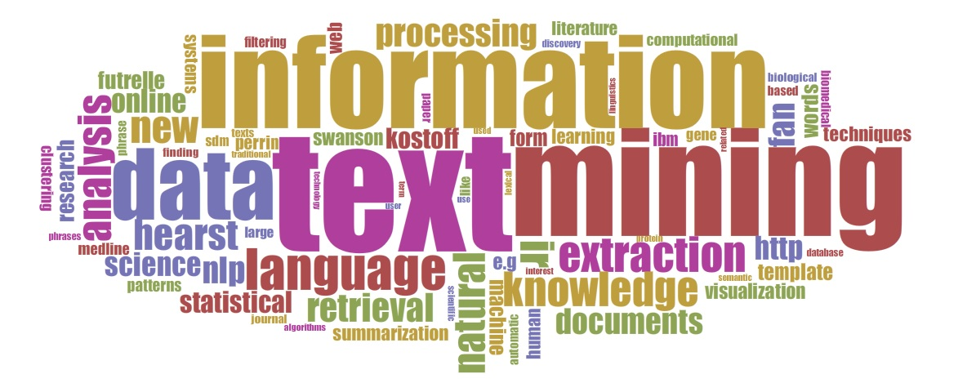

Slide 4
INDEX
What is Clustering?
Types of Clustering
Notes:
Source of information : Reviews from various websites through google search
From this source, we extracted the “dimensions” of the data – which is nothing but the words in the reviews.This adds some implicit structure to the otherwise unstructured data we’re dealing with.
The goal is to identify which are the best books to read.

Slide 5
INDEX
What is Clustering?
Types of Clustering
Notes:
Source of information : Reviews from various websites through google search
From this source, we extracted the “dimensions” of the data – which is nothing but the words in the reviews.This adds some implicit structure to the otherwise unstructured data we’re dealing with.
The goal is to identify which are the best books to read.

Slide 6
What is cluster analysis?
Process of grouping observations of similar kinds into smaller groups within the larger population
Undirected data mining activity
Income
Spend
Notes:
The term cluster analysis encompasses a number of different algorithms and methods for grouping objects of similar kind into respective categories.
A general question facing analysts is how to organize observed data into meaningful structures. Or break a large population into smaller groups that are homogeneous within and heterogeneous without.
Cluster analysis is an exploratory data analysis tool which aims at sorting different objects into groups in a way that the degree of association between two objects is maximal if they belong to the same group and minimal otherwise.
Given the above, cluster analysis can be used to discover structures in data without providing an explanation/interpretation. In other words, cluster analysis simply discovers structures in data without explaining why they exist.This is what is also called as an unsupervised learning technique
------------------------------------------------------------------------------------------
In this example, we have clustered the population along two variables income and spend. Theoretically speaking, you would expect a linear relationship between the 2 variables ie. If Income goes up then spend goes up.
As you can see, the majority of the population follows this trend. However, there are 2 small groups which do not. The group at the top left is spending less in proportion to what they are earning and the 2nd grp on the bottom right is spending more than they are earning. A financial services company selling saving products like ULIP, MFs etc. would be very interested in isolating these groups so they can be targeted differently.
We deal with clustering in almost every aspect of daily life. There is a countless number of examples in which clustering plays an important role.
In food stores items of similar nature, such as different types of meat or vegetables are displayed in the same or nearby locations.
Clustering is used in astronomy to identify anomalies. Red giants and white dwarfs were identified using this approach.
Retail chains tend to cluster groups of stores performing similarly for their marketing strategy purposes.
In short, whatever the nature of your business is, sooner or later you will run into a clustering problem of one form or another.

Slide 7
INDEX
What is Clustering?
Types of Clustering
Notes:
Source of information : Reviews from various websites through google search
From this source, we extracted the “dimensions” of the data – which is nothing but the words in the reviews.This adds some implicit structure to the otherwise unstructured data we’re dealing with.
The goal is to identify which are the best books to read.

Slide 8
Types of Clustering
Kmeans Clustering
Hierarchical Clustering
Notes:
Source of information : Reviews from various websites through google search
From this source, we extracted the “dimensions” of the data – which is nothing but the words in the reviews.This adds some implicit structure to the otherwise unstructured data we’re dealing with.
The goal is to identify which are the best books to read.

Slide 9
Types of Clustering
Kmeans Clustering
Hierarchical Clustering
Notes:
Source of information : Reviews from various websites through google search
From this source, we extracted the “dimensions” of the data – which is nothing but the words in the reviews.This adds some implicit structure to the otherwise unstructured data we’re dealing with.
The goal is to identify which are the best books to read.

Slide 10
Kmeans
What is kmeans?
TDM and Scaling
Distance metric computation
Case Study
Implementation in R

Slide 11
What is kmeans?
4.
K-means is the most important flat clustering algorithm.
Its objective is to minimize the average squared Euclidean distance of documents from their cluster centres
A cluster centre is defined as the mean or centroid of the documents in a cluster
Create clusters
Notes:
The “K” in the name refers to the fact that the algorithm looks for a fixed number (k) of clusters which are defined in terms of proximity of observations to each other.

Slide 12
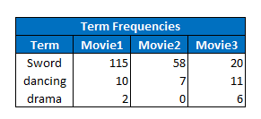
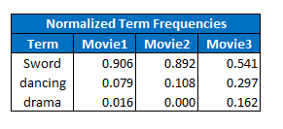

TDM and Scaling
Step1 : Create TDM
Step2 : Normalize the term frequencies
Notes:
Step1 : First create a TDM from the text data given to you.
Step2 :
As usual, given a set of documents, always convert them to numeric indices ie create the term-document matrix. Giving you a quick recap,a Term document matrix basically provides you the term frequencies in each document (tf) , ie number of times each word occurs in every document.
Look at the example shown here.
We have 3 documents :movie1,movie2,movie3 and so forth.
Each movie has say in this case 3 words occurring, sword, dancing and drama.
Out aim here is to check which two movies are similar or in other words check if these documents “belong to the same cluster”
Now that we have the Term document matrix,
Next Step is to Normalise the TDM. What is normalization or scaling of the TDM?
Every document may not have equal number of words and we cannot compare two documents of unequal words. So hence we normalize or scale the document.
For example, the word “Sword “ occurs 115 times in the document Movie1 .Hence it is converted to a percentage of frequencies in the document ie 90% of movie1 document contains “Word” “Sword”
Now what does this mean intuitively?
In the given example, 90% of movie1 and 89% of movie2 talk about “Sword”. These two documents also have similar distribution of the word “Dancing” as well.
This just tells us that these two documents are similar right? Cause they have similar percentages of words occurring.
This is exactly what the clustering algorithm does.
The kmeans algorithm looks at how similar the documents are and clubs them into groups or clusters
IT looks at how similr the documents are and then clubs them together in a cluster.

Slide 13
Distance metric computation
Step3 : Calculate distance metrics
Euclidean Distance calculation
x and y are vectors
x = Movie1
y = Movie2
Notes:
How is this similarity computed?
This is calculated based on the distance metric. There are many kinds of distance measures used to describe how similar the documents are .Over here I am going to show you how the “Euclidean distance “ is calculated between the words/documents.
Since two novels in our corpus now have an expression as vectors, we can calculate the Euclidean distance between them.
The formula for euclideian would be defined as the square root of the square of the distance between vectors.
In this case the two vectors x and y are movie1 and movie2
Now if you actually plug in this formula ,You will see that the distance between between movie1 document and movie2 document is minimum. Hence we can conclude that these two documents belong to the same cluster.
sqrt( 0.9-0.8) squared + (0.07-0.1)squared + ..
This is how the process works.
Finally, you can deploy your kmeans algorithm on the set of documents and form k clusters.

Slide 14
Case Study
K- means clustering of search keywords
This can be done by trying to analyse :
“search keywords” to arrive on the website
And searches within the website
To study the behaviour of your visitors on your website
Notes:
Search keywords :
Let’s look at a case study of how k means clustering is very popularly used in digital analysis .
1.Say you have a website of your own. Here we are trying to study the behaviour of your visitors on your website.
2.This can be done by trying to analyse
a. “search keywords” to arrive on the site
b. And searches within the website
What is a search keyword?
The keywords or searches that were used in google and other search engines to land on your website
For example , if you search “Nike shoes” on google, “Nike shoes” is called the search keyword.
Once you type this word in google, google displays a list of search sites
Like you may see the website “Myntra.com” showcased . So that is the search result or the client’s site that you land on because of the search keyword.
Now within “myntra.com” you may again search for bags or shoes or any item to purchase. These are called as searches within the website.

Slide 15
Implementation in R
Implementation in R
Create tdm
Find the most frequent terms
Choose ‘k’ and run k-means clustering
Notes:
Search keywords :
Let’s look at a case study of how k means clustering is very popularly used in digital analysis .
1.Say you have a website of your own.Here we are trying to study the behaviour of your visitors on your website.
2.This can be done by trying to analyse
a. “search keywords” to arrive on the site
b. And searches within the website
What is a search keyword?
The keywords you use in google and other search engines to land on the client’s website
For example , if you search “Nike shoes”, “Nike shoes” is called the search keyword.
On google search you see the website “Myntra.com” showcased . So that is the search result or the client’s site that you land on because of the search keyword.
Now within “myntra.com” you may again search for bags or shoes or any item to purchase.These are again called searches within the website.

Slide 16
Types of Clustering
Kmeans Clustering
Hierarchical Clustering
Notes:
Source of information : Reviews from various websites through google search
From this source, we extracted the “dimensions” of the data – which is nothing but the words in the reviews.This adds some implicit structure to the otherwise unstructured data we’re dealing with.
The goal is to identify which are the best books to read.

Slide 17
Hierarchical clustering
What is Hierarchical clustering?
Hierarchical clustering Process
Case Study – Implementation in R

Slide 18
Hierarchical clustering
As opposed to the kmeans clustering, hierarchical clustering is a method of cluster analysis which seeks to build a hierarchy of clusters
Notes:
Let’s look at it in detail

Slide 19
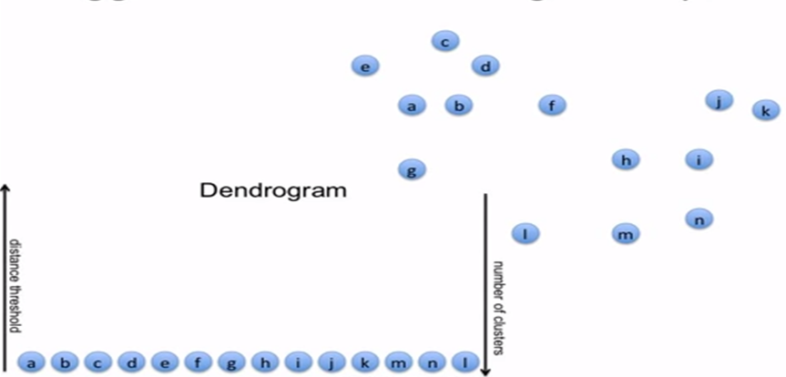
Hierarchical clustering process
Distance threshold
Number of clusters
Notes:
Here are some points in 2 D space. Let’s assume, that each of these points are documents containing words.
Let’s also assume that each one of these points or documents is a singleton cluster.

Slide 20
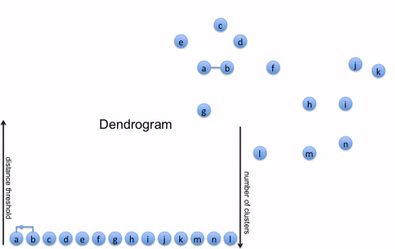
Hierarchical clustering process
Distance threshold
Number of clusters
Notes:
First we look for a pair of clusters which is closest to each other. Here, lets say A and B are close to each other.So we put a link between A and B. So now A and B is a single cluster (A+B).
A dendogram is a tree like structure .
And in the dendogram(this is gong to be my tree) I am putting an edge between A & B. Now the height at which I am putting this edge corresponds to the actual distance between A and B.
When I say distance, as I Explained I n the kmeans algorithm, we compute a distance metric like for example Euclidean distance between the documents. There could be other distance metrics as well such as manhattan methos or Canberra or maximum distance ,and so forth.

Slide 21

Hierarchical clustering process
Distance threshold
Number of clusters
Notes:
What is the next closets pair of clusters? Maybe j and k. Then put a link between them- here the height in the dengogram is slightly higher.
Why is that?Cause the distance between these two clusters is more.

Slide 22

Hierarchical clustering process
Distance threshold
Number of clusters
Notes:
Now the next pair is between c and d

Slide 23
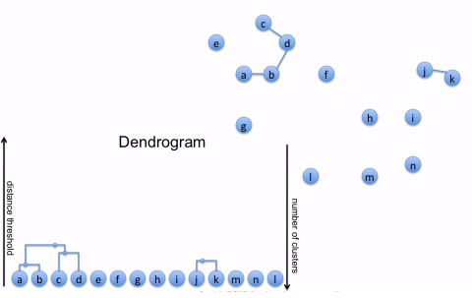
Hierarchical clustering process
Distance threshold
Number of clusters
Notes:
Now the next pair is between b and d. So here I am not merging just b and d, but taking the two clusters a-b, c-d and putting a link between them

Slide 24
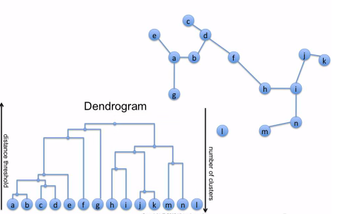
Hierarchical clustering process
Distance threshold
Number of clusters
Notes:
As you keep doing this , more arcs keep coming in the dendogram.
I ll keep doing that until one big cluster is formed.
And also keep connecting the arcs and branches in the dendogram.
This is your entire tree which we call as dendogram

Slide 25
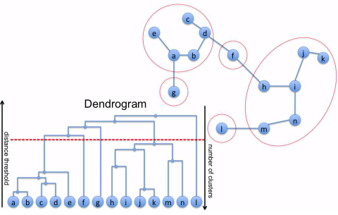
Hierarchical clustering process
Distance threshold
Number of clusters
Notes:
What does a dendogram represent? It represents the hierarchical structure of your data. It tells you how our data is organised in space.
If you want to produce a flat clustering, what you do is pick a threshold on the distance. And you cut that tree at that distance threshold.
Every node that comes through this red line becomes a cluster.So here the custers are :
1.a,b,c,d,e
2.f
3.g
4.h,I,j,k,m,n
5.L
So totally we have 5 clusters which you can see is also circled .
Once you have a dendogram, you can cut in any place you want.
So you see if you cut closer to the top of the dendogram , you get fewer bigger clusters.
If you cut at the bottom, you get many smaller clusters.

Slide 26
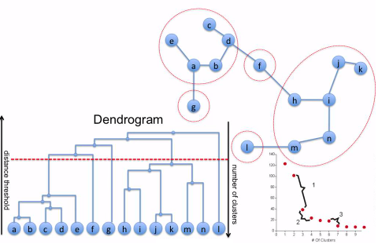
Hierarchical clustering process
Distance threshold
Distance threshold
Number of clusters
Number of clusters
Notes:
#How to choose number of clusters?
IT’s similar to kmeans.You can plot the distance (or any other variance metric) Vs #clusters.After a point you will see that even if the number of clusters increases,
The distance still remains the same.
In this case if you observe the graph, if number of clusters is >=5, the distance remains almost constant. Then you can choose optimal clusters as5

Slide 27
Cast Study – Implementation in R
Data : Obama Tweets
Create tdm
Find the most frequent terms
Use “hclust” algorithm
Notes:
Let’s look at how we can implement hierarchical clustering in R with the example of Tweets pulled from twitter about “Obama”

Slide 28

RECAP
Notes:
Closing Audio to be recorded
Under this topic we have discussed in detail about
…..
That’s it for this topic.
For any queries, do email us at info@jigsawacademy.com
Thanks!

Slide 29
THANK YOU

